Slide 1
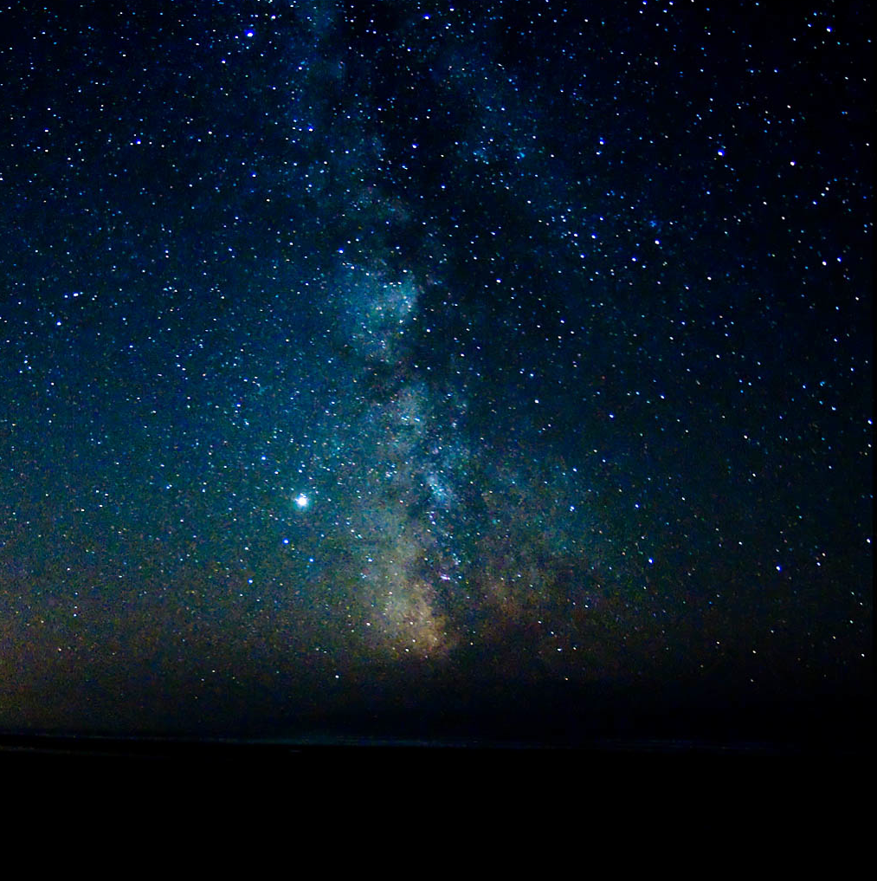
Better Lights for Better Nights!
The Reality of “Dark Sky” Practices
Presented by
Cindy Luongo Cassidy
Notes:
We all need light to see at night. You hear people say they want a “Dark Sky” ordinance. What does that mean to our lighting? What is the reality of “Dark Sky” practices?

Slide 2
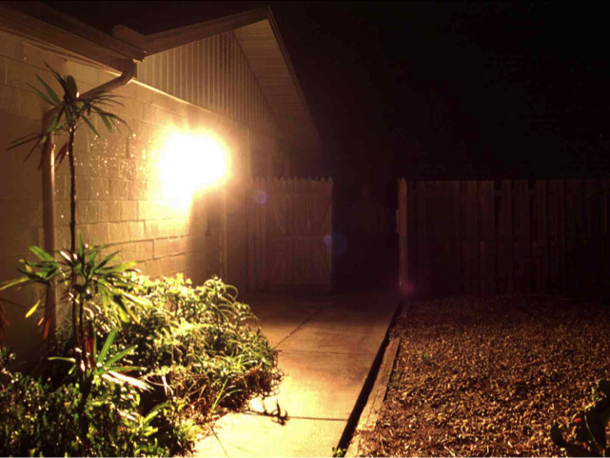
Does this Light Make You Feel Safe?
George Fleenor
Notes:
First let’s look at the challenges we face with light at night. Here’s a typical “security” light. Do you feel safe? What if we could reduce that GLARE?

Slide 3
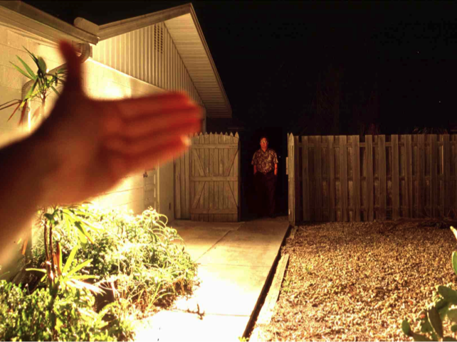
Glare creates dark shadows!
George Fleenor
Notes:
We shield the light to see better and – hold on – Do you see that man standing in what was a dark shadow in the first photo?
Go back - he was there all along! You are NOT secure when a light produces GLARE.
Now, let's look at GLARE and SAFETY.

Slide 4
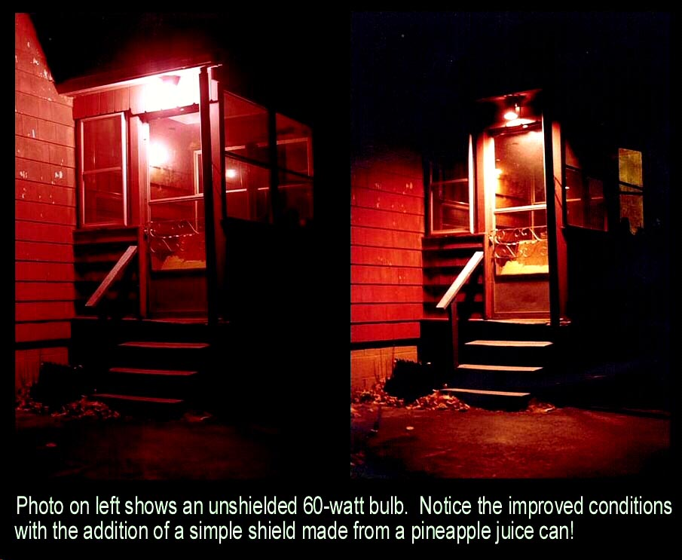
Glare & Entrance Safety
Southern Az Section IDA
Notes:
See how the light on the left produces GLARE? Now look at the improvement on the right when the light is shielded.
The homeowner has taken a pineapple juice can, cut out the bottom and a small hole to fit over the fixture, painted it to match the house and installed it around the bulb.
This inexpensive homemade shield protects your eye from the source of the light and points the light down & out where it’s needed. In doing so, visibility is improved, and you can see where you’ll be walking.
Have you ever really looked at the lights around your home or business at night? Do they improve safety or blind you with glare? Do they waste your money by sending light where you don’t need it? This little shielded fixture is a simple example of Dark Sky Lighting Practices!

Slide 5
Light Intrusion
Notes:
These two buildings are across the street from each other. The home on the right has NO OUTSIDE LIGHTS ON. All of the light is coming from the lights across the street. That would certainly make it tough to sleep in that home at night.
Natural light changes during the day & at DUSK the change in the color (and reduction of what's called blue light) triggers our bodies to produce melatonin.
In fact, almost every living thing on this planet produces melatonin at night.
Artificial light at night - especially bright white looking light - suppresses that production of melatonin. Melatonin not only helps us sleep but it's key in rebuilding our immune systems. It even stops the growth of many cancer cells every night.
That intrusive white light coming into your home at night could damage your health.
What happens when that light is shielded so that it doesn’t intrude on other properties?

Slide 6
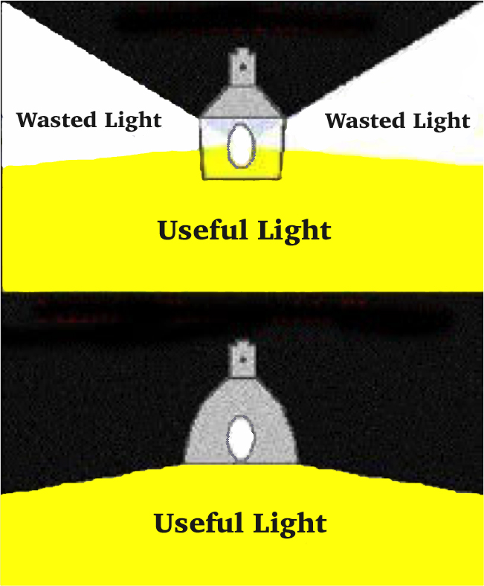
Shielding to Reduce Wattage!
Notes:
A shielded light will allow the owner to reduce the wattage approximately in HALF and get the same amount of useful light. HALF! That reduces the electrical cost in half. It cuts the amount of fuel needed to produce that energy in HALF. Plus it puts the light where it’s needed and reduces that GLARE that makes us less safe and secure. Are you seeing the win-win here? There’s more…..

Slide 7
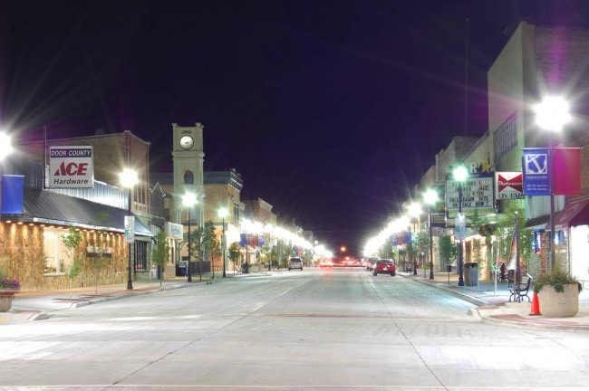
Will Light Clutter Attract Tourists?
Notes:
Too much light can detract from what we want tourists to be attracted to. Seeing the source of each light is BLINDING. We want everyone to be comfortable and see well at night – NOT be blinded by glare and ugly light clutter. And, here are even more reasons to put our light only where it’s needed…...

Slide 8
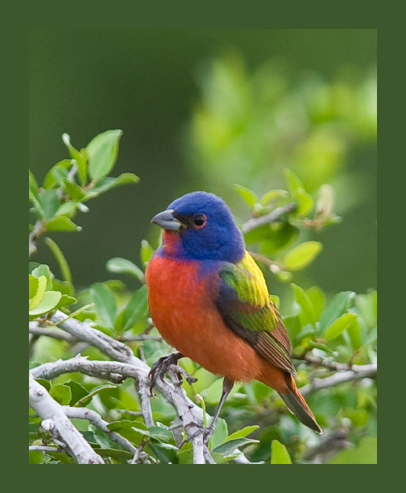
Life on Earth Depends on
Natural Darkness!
Photo courtesy
Susan RIley
Notes:
Almost all living things – plants and animals – need natural darkness to thrive. Our artificial lights disrupt the navigational systems of many animals, including our beautiful migratory birds. They cause the disruption of reproductive processes, circadian rhythms, and yearly cycles. It alters when plants will bloom. It changes the balance between predators and prey. Our artificial light can cause habitat destruction just as surely as a bulldozer. What can we do about that and about the other artificial light challenges we’ve talked about?

Slide 9
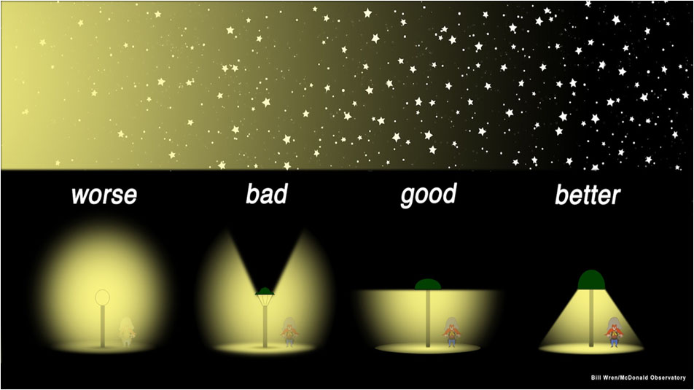
Shield & Aim Lights Down
Notes:
Let's LOOK at this – some common styles for so-called “Security Lights” vs a light shielded so that you don’t see the source of the light.
We can have the outdoor lighting we need and yet see better with shielded lighting. We can reduce glare, increase safety, reduce light intrusion, save money, have a more attractive community, and protect the night sky all at the same time.
That, my friends, is what Dark Sky Lighting is about!

Slide 10
Yes, You Can
Light Right for Sight at Night!
See Better & Be Safer
Be a Good Neighbor
Save Money
Protect Your Health
Protect Your Heritage of the Night Sky
Notes:
Yes, You Can Light Right for Sight at Night!
I challenge you to shield and reduce the amount of light in each fixture and see better at night!

Slide 11
Questions?
Thank you!
Notes:
Stop here! The next slide is just for you.

Slide 12
Online Presentation
To see this presentation as given at the San Antonio Sustainability Conference in 2016 go here:
https://m.youtube.com/watch?v=WON27PefM9w
Notes:
This slide is for the presenter who is learning this presentation to see an example of it done in less than 7 minutes per the requirements of that specific conference.

